Slide 1
Public Key Distribution Authority

Slide 2
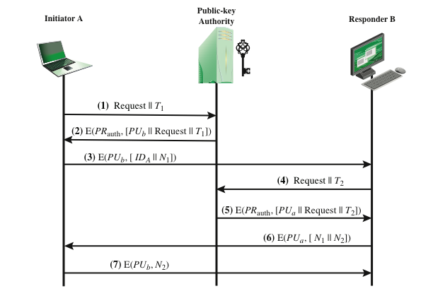
PROBLEM STATEMENT
To build a PKDA, and build clients that wish to confidentially send messages suitably encrypted with public key of receiver, but only after they know the other client’s public key in a secure manner using PKDA.

Slide 3
SYSTEM SPECIFICATION
Language Used : Python
Assumptions :
1. PKDA has public keys of Client A and Client B.
2. Clients A and B have their private keys and public key of PKDA.

Slide 4
SYSTEM DESIGN
Client A
PKDA
Client B
Key Generation by PKDA (Based on assumption)
Request for PU(B) [Encoded in base64]
PU(B) encrypted with PR(PKDA)
Nonce and ID(A) encrypted with PU(B)
Request for PU(A) [Encoded in base64]
PU(A) encrypted with PR(PKDA)
Nonces encrypted with PU(A)
Nonce response encrypted with PU(B)
Conversation between A and B using PU(B) and PU(A)

Slide 5
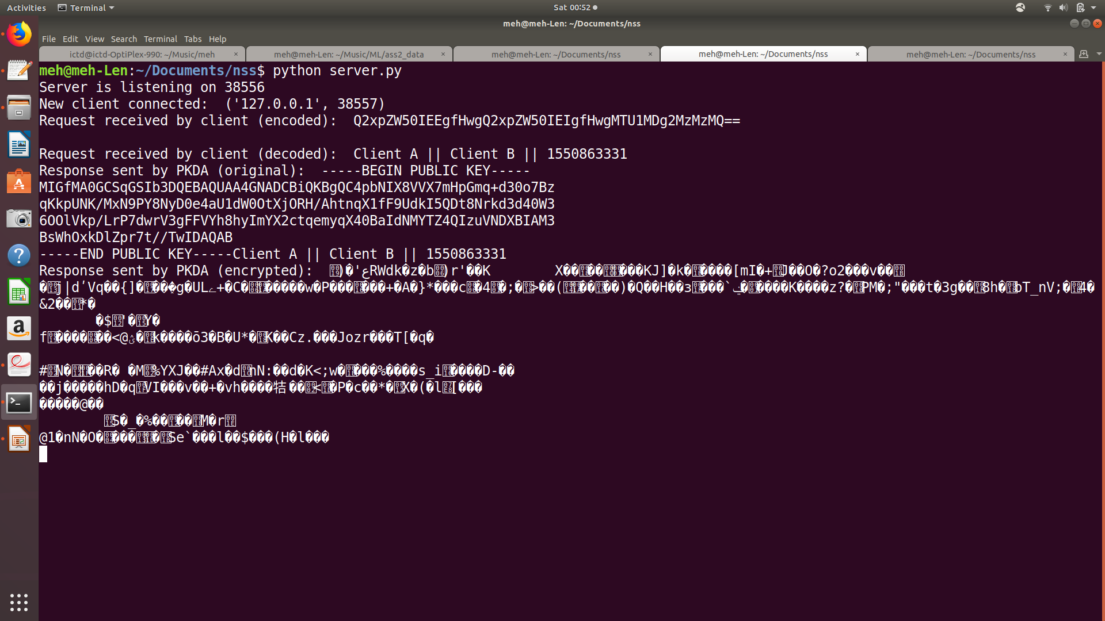
COMMUNICATION BETWEEN CLIENT A & PKDA

Slide 6
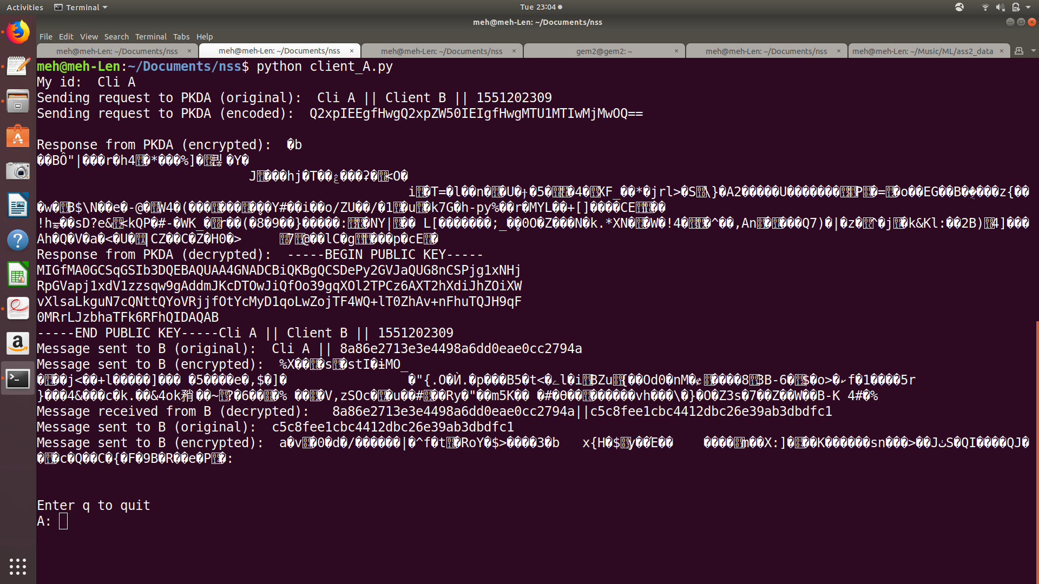

Slide 7
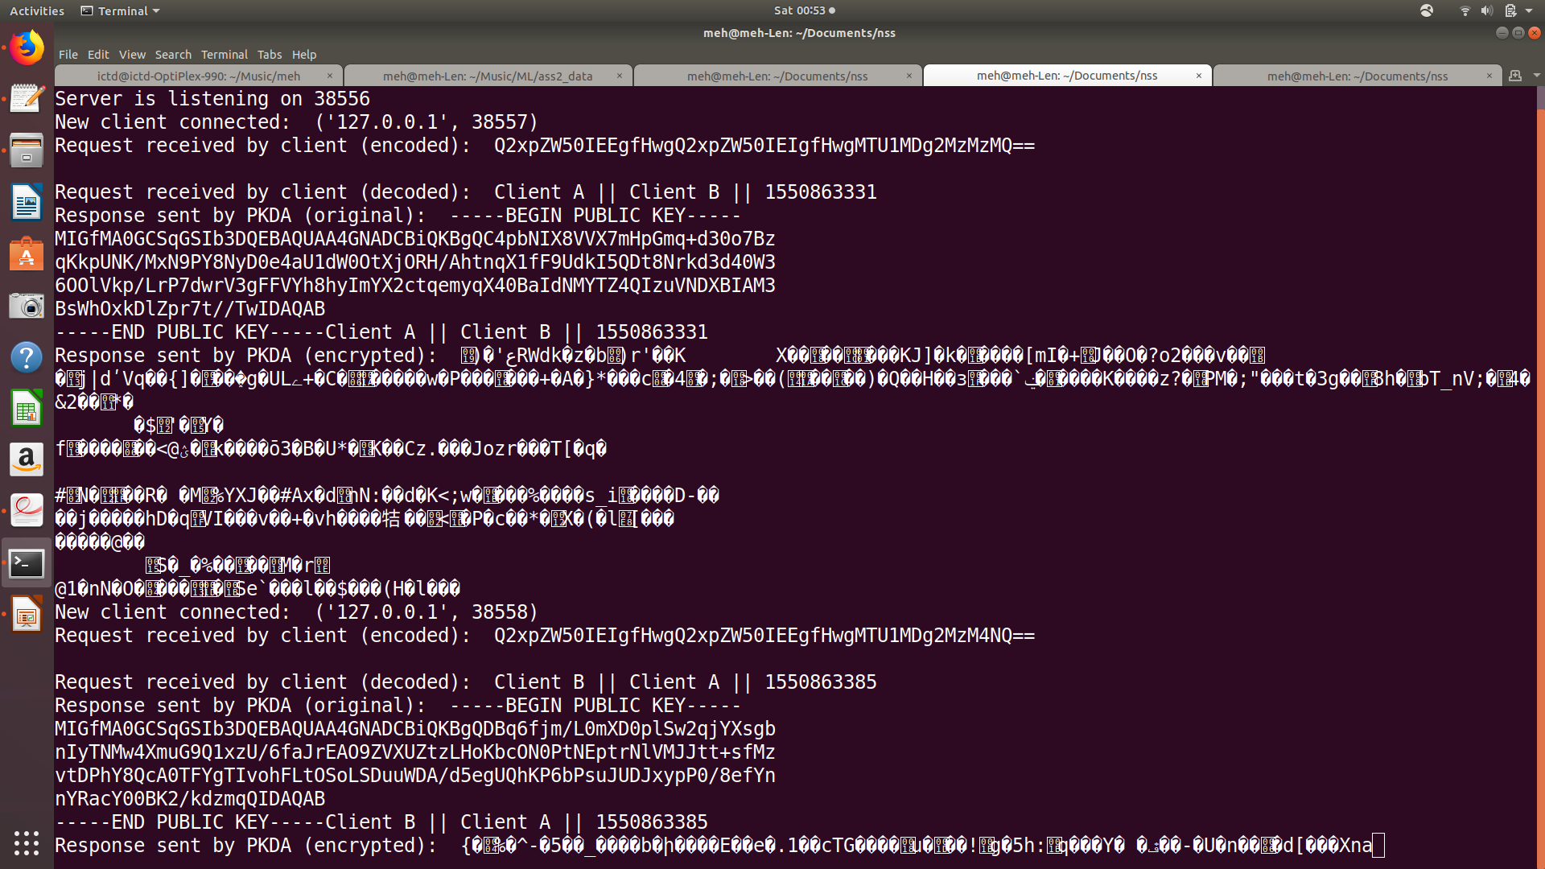
COMMUNICATION BETWEEN CLIENT B & PKDA

Slide 8
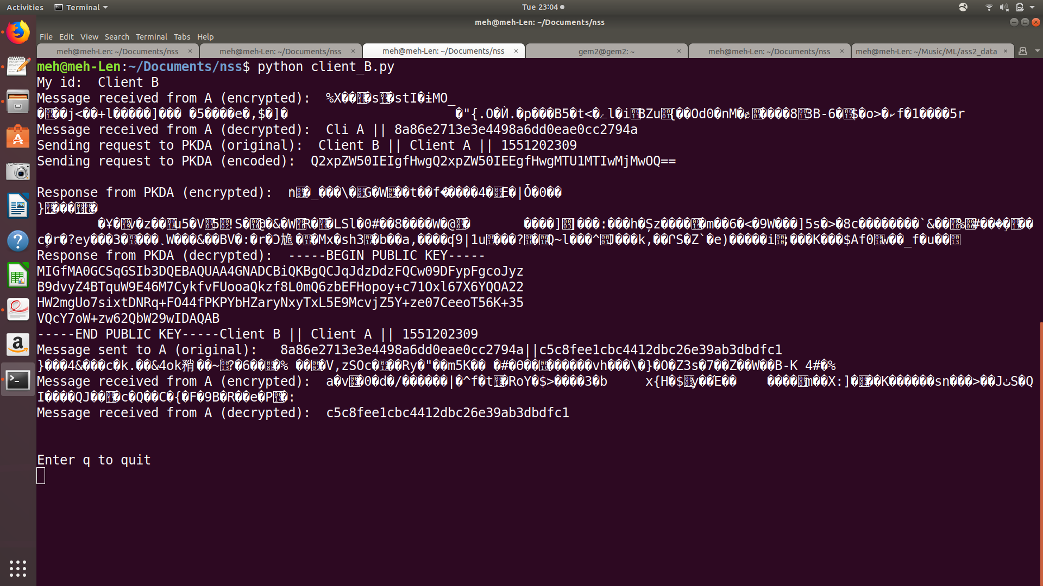

Slide 9
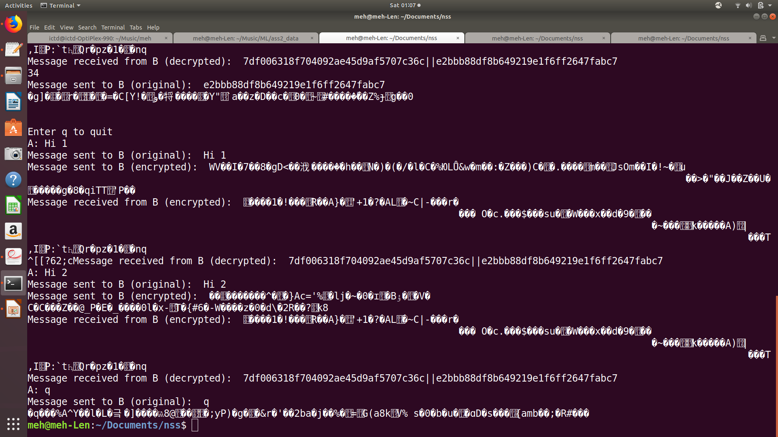
COMMUNICATION BETWEEN CLIENT A & B

Slide 10
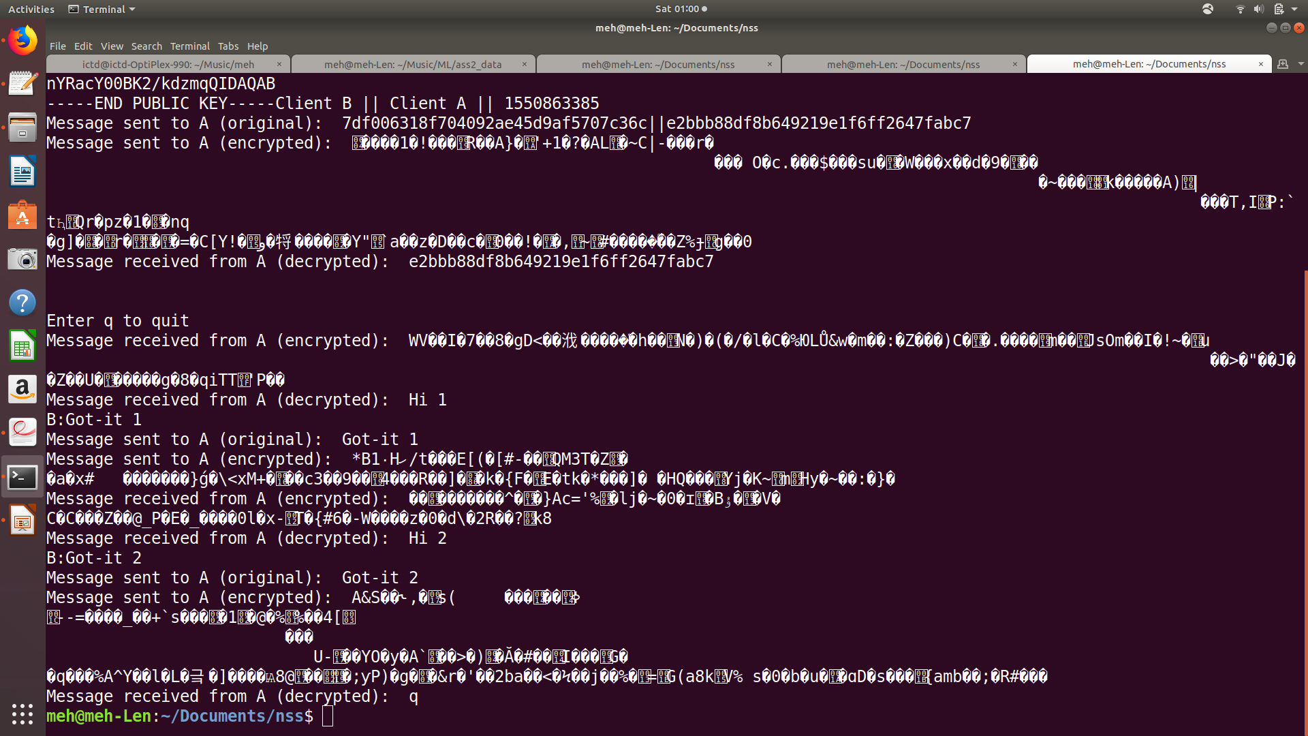

Slide 11
THANK YOU

